Slide 1
Kohonen Self Organizing maps
Session 9

Slide 2
Introduction
A Self-organizing Map is a data visualization technique developed by Professor Teuvo Kohonen in the early 1980’s.
SOMs generate subspaces with an unsupervised learning neural network trained with a competitive learning algorithm.

Slide 3
Applications
Dimensionality reduction using SOM based technique for face recognition
A comparative study of PCA, SOM and ICA
SOM is better than the other techniques for the given face datea base and the classifier used
The result also show that the performance of the system decreases as the number of classes increases.

Slide 4

Algorithm
Step1: Initialize the weights Wij random values may be assumed. Intitialize the learning rate alpha.
Calculate square of the Euclidean distance, i.e, for each j= 1 to m
D(j)=$\sum_{i=1}^{n}{\sum_{j=1}^{m}{\left(Xi−Wj\right)2}}$
Y1
Y2
W11
W12
X1
X2
X3
X4

Slide 5
Step2: find winning unit index J, so that D(j) is minimum.
Step3: For all units J within a specific neighborhood of J and for all I, calculate new weights
Wij(new) = Wij(old)+ alpha(Xi-Wij(old))
Step4: Update learning rate alpha using the formula alpha(new) = 0.5 * alpha(t)

Slide 6
Example
Construct self organizing map to cluster four given vector [0011], [1000], [0110] and [0001]. No. of clusters to be formed is 2. Assume an initial learning rate of 0.5

Slide 7
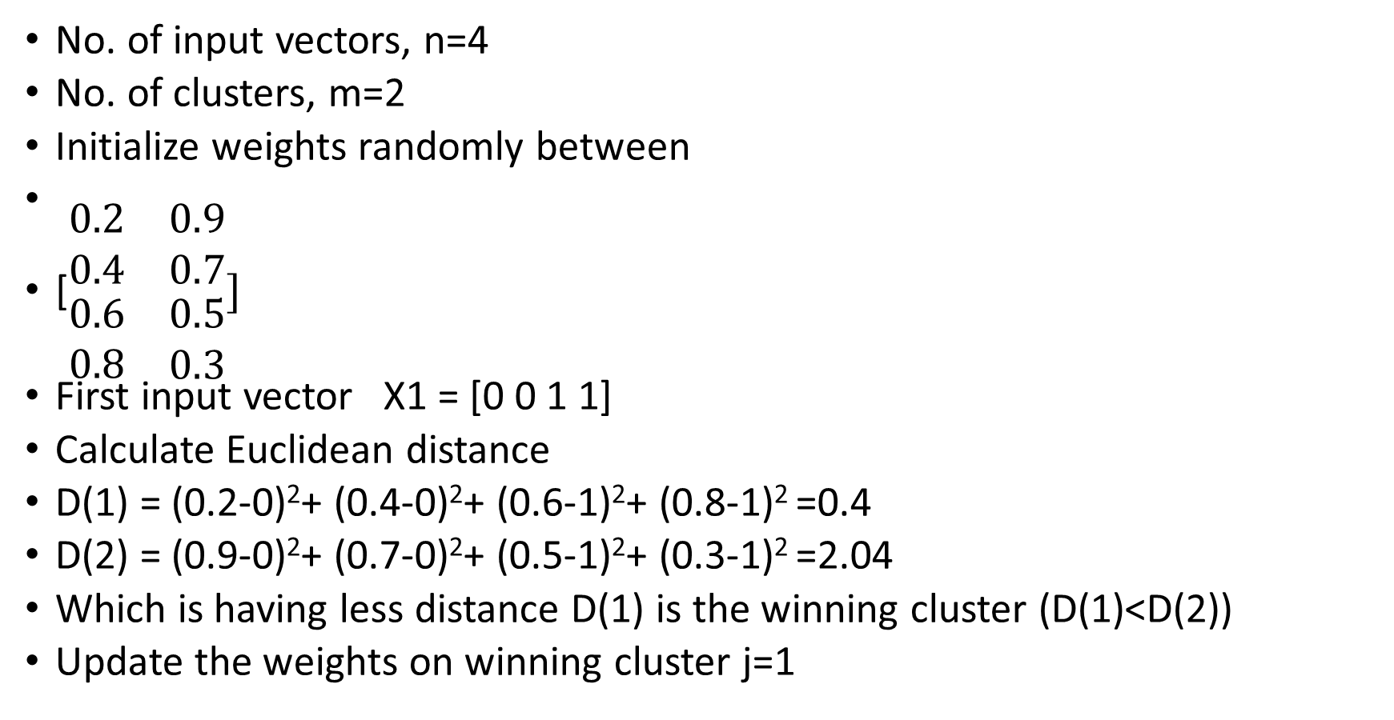
Solution
No. of input vectors, n=4
No. of clusters, m=2
Initialize weights randomly between
[$\begin{matrix}0.2 & 0.9 \\ 0.4 & 0.7 \\ \begin{matrix}0.6 \\ 0.8\end{matrix} & \begin{matrix}0.5 \\ 0.3\end{matrix}\end{matrix}]$
First input vector X1 = [0 0 1 1]
Calculate Euclidean distance
D(1) = (0.2-0)²+ (0.4-0)²+ (0.6-1)²+ (0.8-1)² =0.4
D(2) = (0.9-0)²+ (0.7-0)²+ (0.5-1)²+ (0.3-1)² =2.04
Which is having less distance D(1) is the winning cluster (D(1)<D(2))
Update the weights on winning cluster j=1

Slide 8
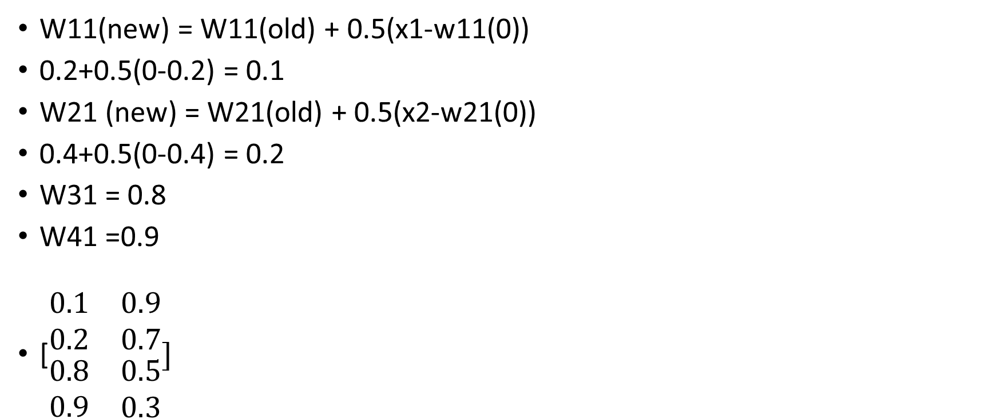
Weights Update
W11(new) = W11(old) + 0.5(x1-w11(0))
0.2+0.5(0-0.2) = 0.1
W21 (new) = W21(old) + 0.5(x2-w21(0))
0.4+0.5(0-0.4) = 0.2
W31 = 0.8
W41 =0.9
[$\begin{matrix}0.1 & 0.9 \\ 0.2 & 0.7 \\ \begin{matrix}0.8 \\ 0.9\end{matrix} & \begin{matrix}0.5 \\ 0.3\end{matrix}\end{matrix}]$

Slide 9
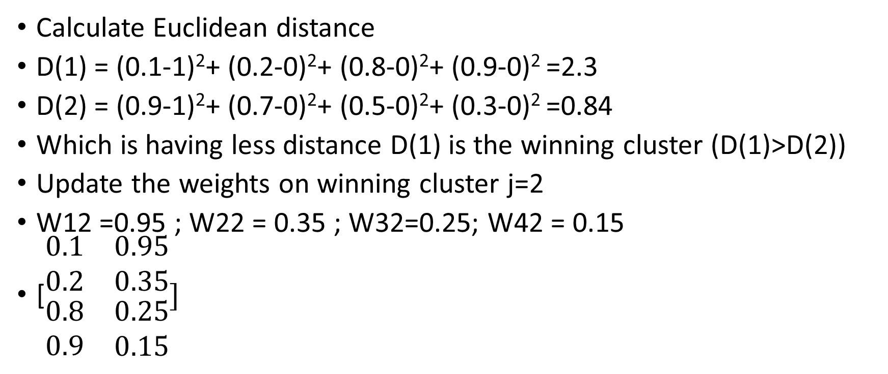
Second input vector x = [1000]
Calculate Euclidean distance
D(1) = (0.1-1)²+ (0.2-0)²+ (0.8-0)²+ (0.9-0)² =2.3
D(2) = (0.9-1)²+ (0.7-0)²+ (0.5-0)²+ (0.3-0)² =0.84
Which is having less distance D(1) is the winning cluster (D(1)>D(2))
Update the weights on winning cluster j=2
W12 =0.95 ; W22 = 0.35 ; W32=0.25; W42 = 0.15
[$\begin{matrix}0.1 & 0.95 \\ 0.2 & 0.35 \\ \begin{matrix}0.8 \\ 0.9\end{matrix} & \begin{matrix}0.25 \\ 0.15\end{matrix}\end{matrix}]$

Slide 10
Continue….
Same as that repeat for 3rd and 4th input vector and update the weights

